Slide 1
Application Function Library

Slide 2
Application Function Library
SAP HANA In-Memory Computing Engine offers various algorithms for in-memory computing. It provides several application libraries for developers, partners, and customers who develop applications that run on SAP HANA. The libraries are linked dynamically to the SAP HANA database kernel.
SAP HANA appliance offers various pre-delivered commonly utilized business and predictive algorithms. These functionalities are stored in the Application Function Library (AFL). Customers can use these functions to speed up both: implementation and performance.
AFL functions run in the core of SAP HANA in-memory DB, and are therefore specifically optimized for performance.
Application Functions written in C++.
In order to use the Application Function Library you need to install it on your SAP HANA deployment.
Business Function Library (BFL)
It contains pre-built, parameter-driven, commonly used algorithms primarily related to finance.
Predictive Analysis Library (PAL)
The PAL contains pre-built, parameter-driven, commonly used algorithms primarily related to predictive analysis and data mining.

Slide 3
Checking AFL Installation
To confirm that the BFL functions were installed successfully, you can check the following three public views:
sys.afl_areas
sys.afl_packages
sys.afl_functions
These views are granted to the PUBLIC role and can be accessed by anyone.
To check the views, run the following SQL statements:
SELECT * FROM "SYS"."AFL_AREAS" WHERE AREA_NAME = 'AFLBFL';
SELECT * FROM "SYS"."AFL_PACKAGES" WHERE AREA_NAME = 'AFLBFL';
SELECT * FROM "SYS"."AFL_FUNCTIONS" WHERE AREA_NAME = 'AFLBFL';
The result will tell you whether the BFL functions were successfully installed on your system.
Authorization:
Roles Required:
AFL__SYS_AFL_AFLBFL_EXECUTE & AFL__SYS_AFL_AFLPAL_EXECUTE (There are 2 underscores between AFL and SYS.)
- To execute the functions in the library
AFLPM_CREATOR_ERASER_EXECUTE
- To generate or drop procedures

Slide 4
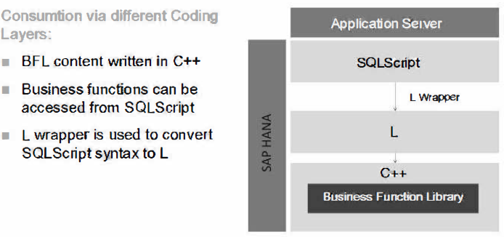
Business Function Library (BFL)

Slide 5
BFL - Sample Functions
Annual Depreciation
Calculates annual depreciation according to three common methods: Diminishing balance depreciation, Straight line depreciation and Sum-of-year depreciation. It allows variable length of timescales for all assets/items.
Cumulate
Calculates the cumulative totals in one row based on the original numbers in another row.
Delay Debt
Calculates cash receipts using actual sales. The closing debtor balance for each period is calculated by referring to historic sales levels for a specified number of days.
Forecast
Combines actual and forecast data to produce a rolling forecast. Eliminates scripting of feeds.
Inflated Cash Flow
Calculates the amount of cash you must receive in a future period to compensate for inflation.
Number of Periods
Calculates the number of periods over which the account must run
Payment
Calculates the regular payment to an account for each period.
Stock Flow
Works out the level of supply needed to meet target forecasts for stock cover.
Year over Year Difference
Calculates the Year over Year Difference between the current and previous time periods.

Slide 6
Predictive Analysis Library (PAL)
Association Analysis
Apriori
Apriori Lite
Cluster Analysis
K-Means
Kohonen Self Organized Maps
Classification Analysis
C4.5 Decision Tree Analysis
CHAID Decision Tree Analysis
K Nearest Neighbour
Multiple Linear Regression
Polynomial Regression
Exponential Regression
Bi-Variate Geometric Regression
Bi-Variate Logarithmic Regression
Logistic Regression
Time Series Analysis
Single Exponential Smoothing
Double Exponential Smoothing
Triple Exponential Smoothing
Outlier Detection
Inter-Quartile Range Test
(Tukey's Test)
Variance Test
Anomaly Detection
Data Preparation
Sampling
Binning
Scaling
Other
ABC Classification
Weighted Scores Table

Slide 7
THANK YOU
Courtesy : SAP Labs Document -
HA 300 – SAP HANA Implementation and Modeling

